Slide 1
March 2025
AI ML Specialist Interview
Prash Medirattaa
Principal Partner Engineer - AI/ML

Slide 2
Introduction
Why me
Snowflake Opportunity
Challenges
Plan
Scaling
Agenda

Slide 3
My Key Qualifications Strengths
I bring a unique combination of technical depth, business acumen, and relationship skills that make me the right fit for this AI/ML specialist role.
💻Technical Expertise/ Qualification Deep understanding of AI/ML technologies, architectures, and implementation strategies | ❄️Snowflake Ecosystem Specialized knowledge of Snowflake's capabilities and how to leverage the platform for AI/ML workflows
🏆 Cross-functional Champion Skilled at aligning stakeholders across organizational boundaries to drive consensus and implementation | 🤝 AI ML Partner Landscape Comprehensive understanding of the AI ML partner ecosystem and how to leverage these relationships
🚀 Proven Track Record Successfully spearheaded multiple strategic initiatives, most notably leading the SPCS & Native applications launch in collaboration with key partners | 💥 Impact-Driven Focused on creating meaningful business outcomes and measurable customer value
⚙️ Process Driven Structured approach to solution implementation with clear methodologies and frameworks | 📊 Sales & Consulting Blend of solution selling and consultative approaches that prioritize customer outcomes

Slide 4
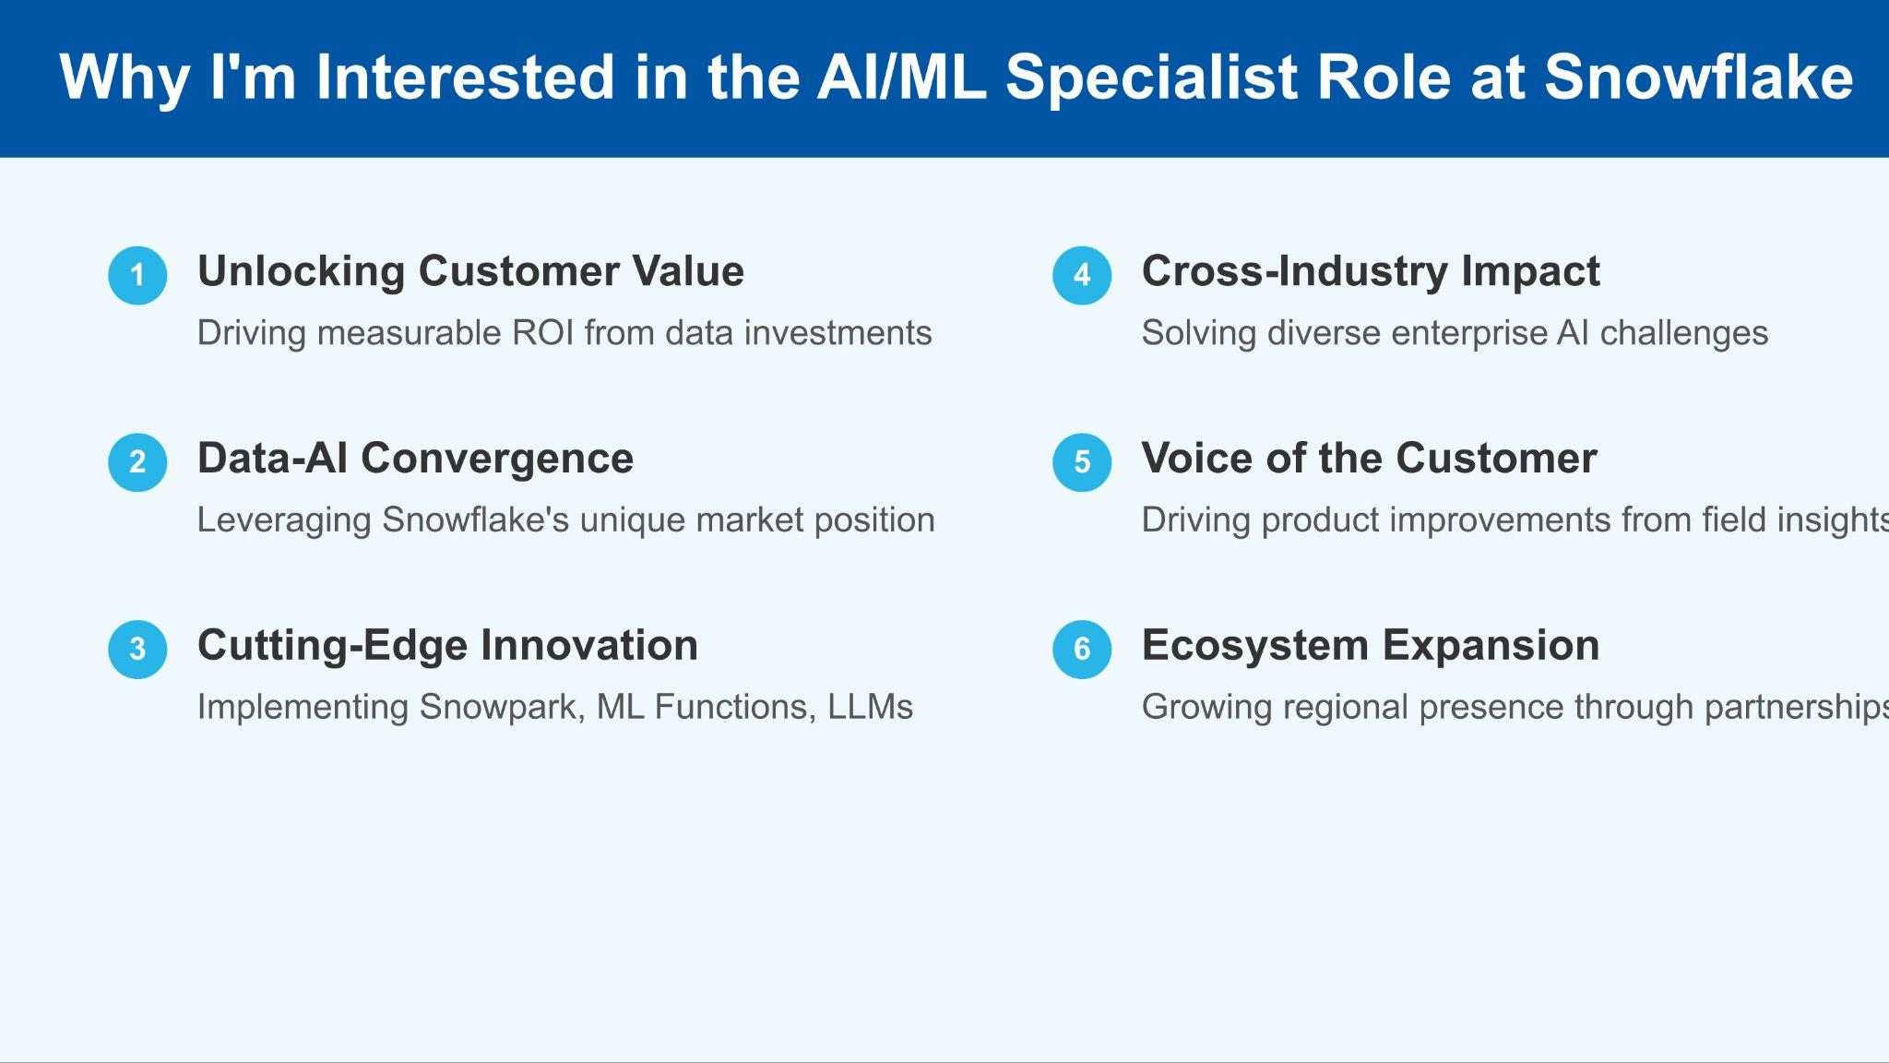

Slide 5
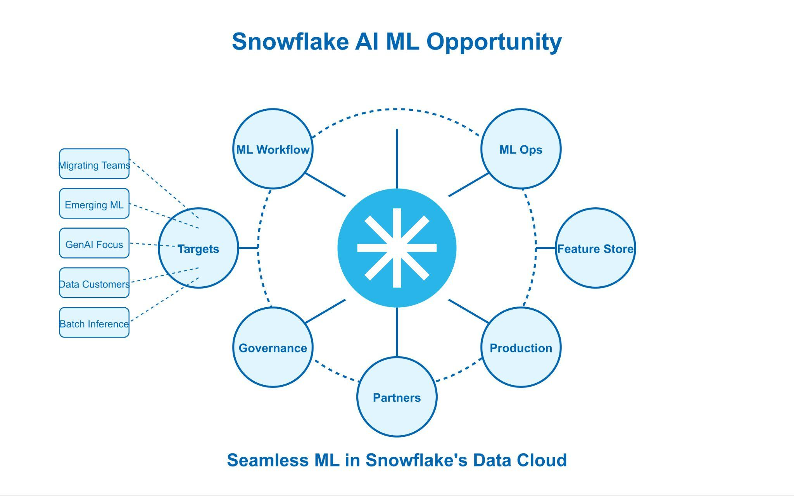

Slide 6
What Challenges we can see ?
Adoption
Cost Perception
Competition
Trust & Scalability
Technical Barriers
Migration Resistance
Legacy systems
Big Mass appeal
Skill Requirements
ROI is not clear
Value perception
Justification needed
Budget Predictability
Great team to execute
Matured AI ML practise
Already Invested
Differentiation Struggle
Market Perception
Technical resources
Security concerns
Scalability worries
Protect provider Ip & consumer data
Big Mass appeal
Great team to execute
Notes:
Adoption and Integration Complexity
Technical Barriers: Customers may struggle to integrate Snowflake’s AI/ML tools (e.g., Snowpark, Cortex) into existing workflows, especially with legacy systems or competing platforms.
Migration Resistance: Organizations invested in other ecosystems (e.g., Databricks, AWS) might hesitate to shift data pipelines to Snowflake.
Skill Requirements: Effective use requires specialized expertise, which some customers lack, slowing adoption.
2. Cost and Value Perception
Pricing Concerns: Snowflake’s consumption-based model can lead to high costs for AI/ML workloads, raising customer skepticism about ROI.
Justification Needed: Tangible benefits (e.g., efficiency gains, revenue growth) must be proven to offset perceived expense.
Budget Predictability: Unpredictable compute demands may deter buyers favoring fixed-cost alternatives.
3. Competitive Landscape
Strong Rivals: Established players like Databricks, AWS SageMaker, and Google Cloud AI offer mature ecosystems, challenging Snowflake’s newer AI/ML stack.
Differentiation Struggle: Customers may question why Snowflake over competitors, requiring clear articulation of unique value (e.g., data-AI unification).
Market Perception: Snowflake’s reputation as a data warehouse might overshadow its AI capabilities, necessitating education.
4. Trust and Scalability
Data Security Risks: Concerns over privacy, compliance, or past incidents (e.g., 2024 credential theft) could undermine confidence in Snowflake for AI workloads.
Governance Needs: Customers handling sensitive data demand robust assurances of security and regulatory alignment.
Scalability Worries: Spiky AI/ML workloads might strain cost management, pushing sellers to offer optimization solutions.

Slide 7
Time lapse plan
30- Days
Foundation & Learning
60- Days
Strategic Positioning
90 Days
Transformation Impact
Deep Dive Platform
Learn Maturity model
Skill development & Training
Shadowing customer calls
AE/ SE introduction
Cross functional team Alignment
Identify Key Accounts
Craft Target Strategy
Lead Discovery Sessions
Define success metrics
Build Pipeline
Create Assets
Execute POC
Scale Opportunities
Comprehensive Feedback Integration
Strategic Partner Ecosystem development
Industry approach

Slide 8
Scaling
Artifacts
Internal
External
Quickstart Guides
Work books
Solution Page
Accelerators
Industry Solution Development
Training
Office hours
Geo Coverage
Leverage Champion Program
Best Practise page
Webinars
Self Service templates
SI engagements
Design Workshop

Slide 9
THANKYOU

Slide 10
Opportunities !
Scale & Accelerate all apps on Snowflake
Support theater
Centre of excellence
Quantifying
Native App
Managed App
Connected App
Data Providers
Industry
Media / Marketing
AI / ML & Platforms
Enterprise
Workshops /Training
Develop Accelerators
Solution Center
Pilot to POC
Scalability*
GTM
Increase Providers
App builders
Listing
Consumption
Cap1

Slide 11
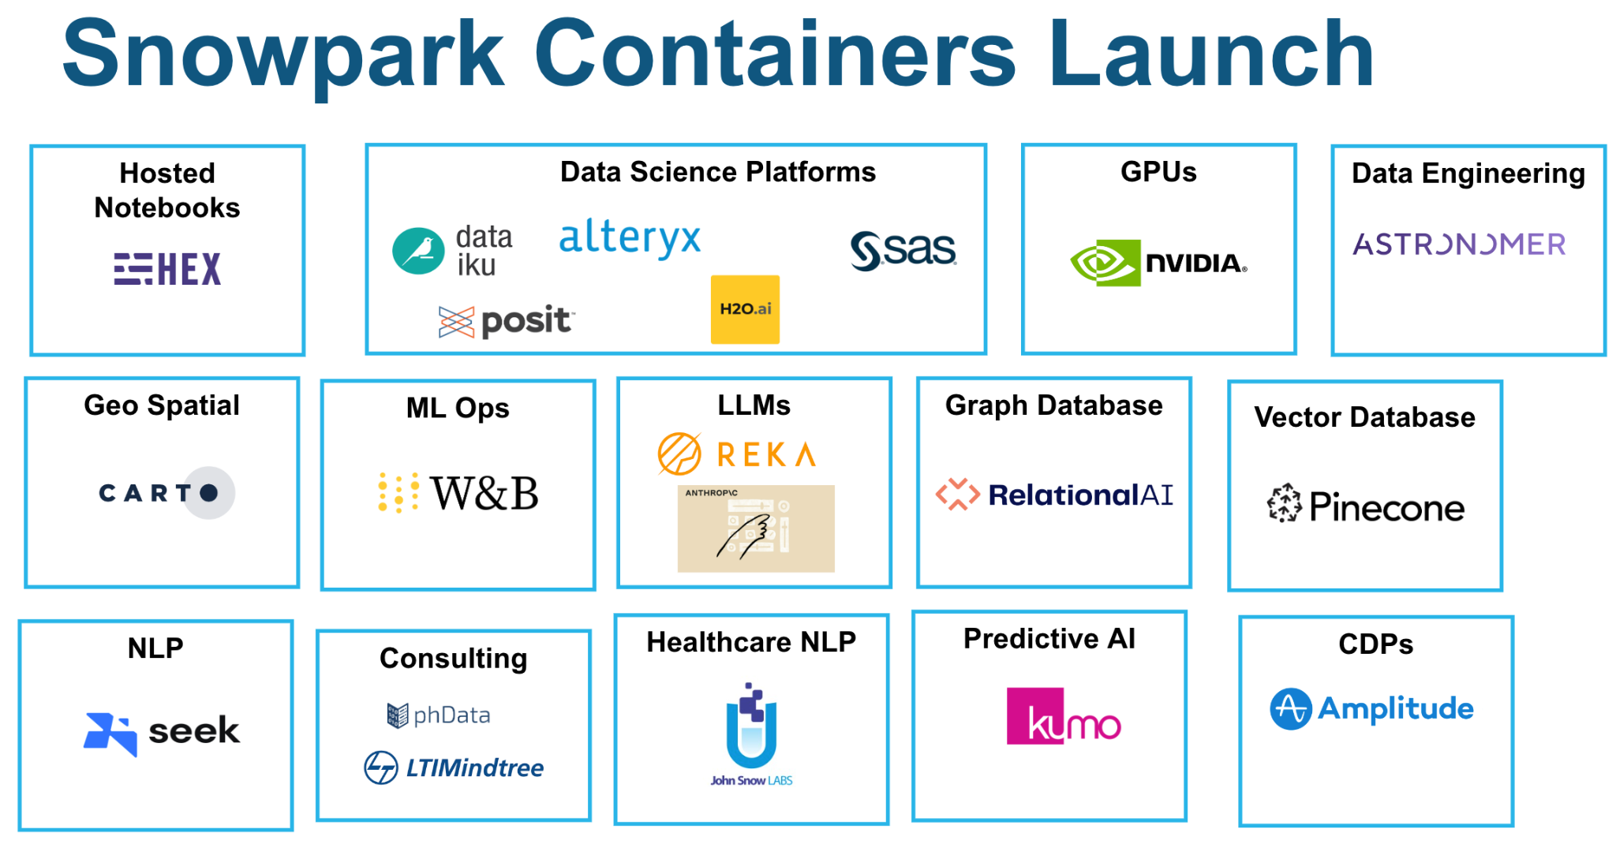
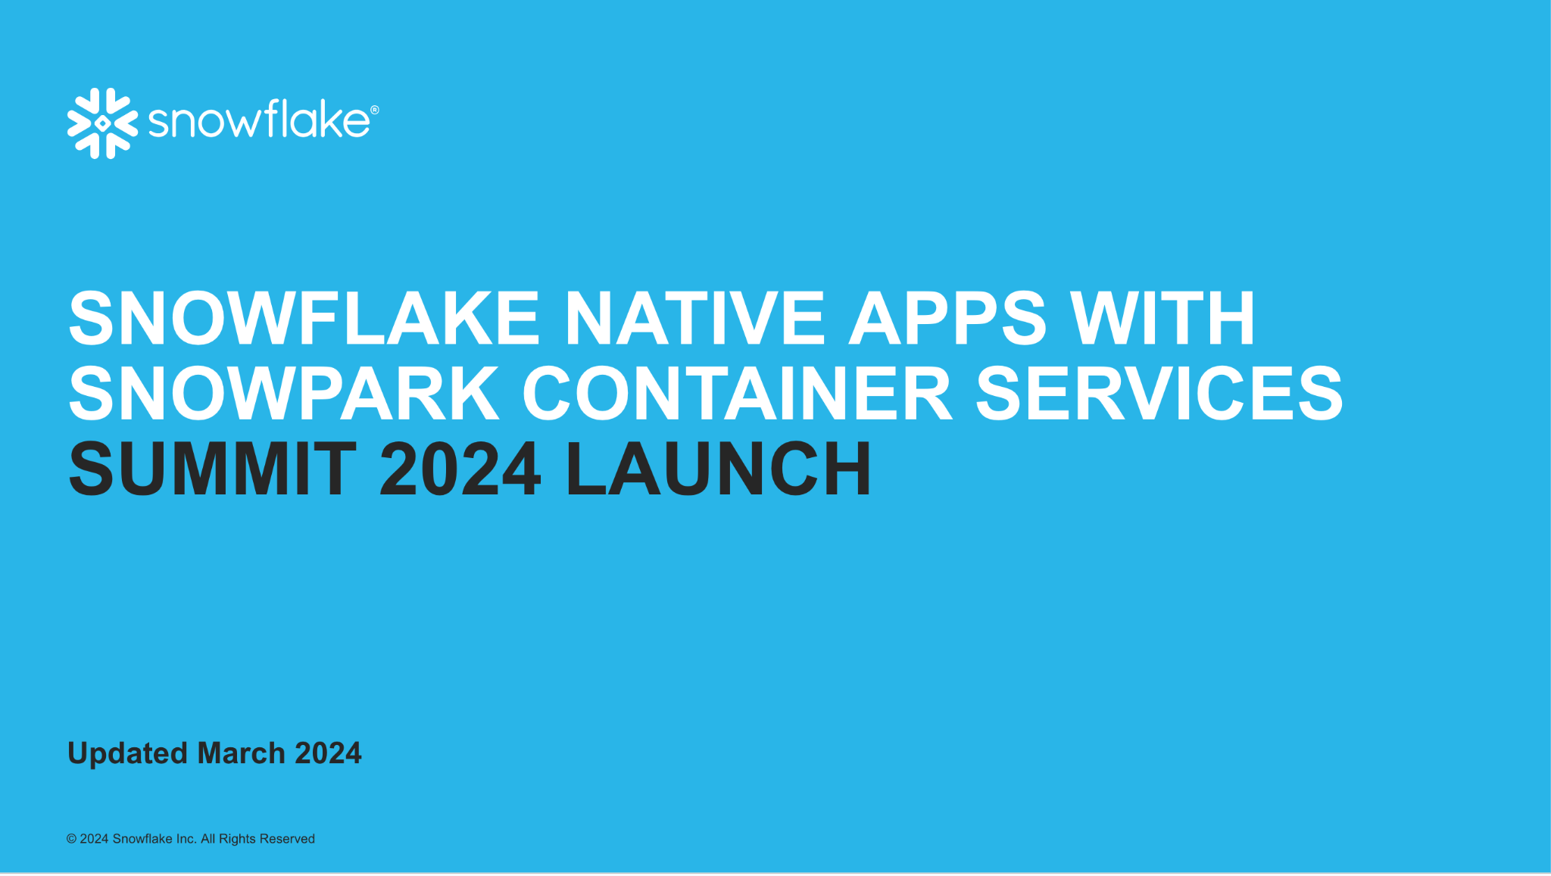
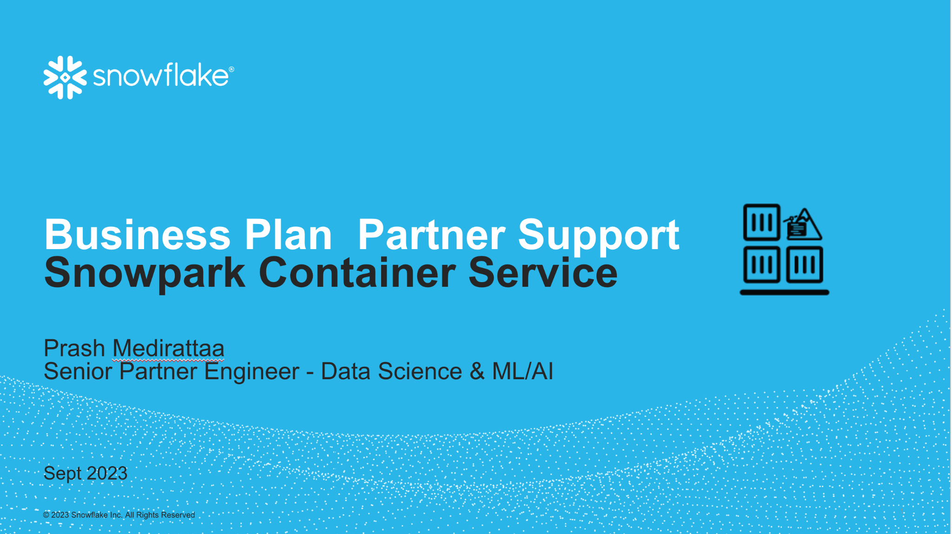
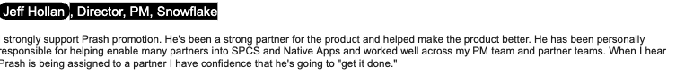
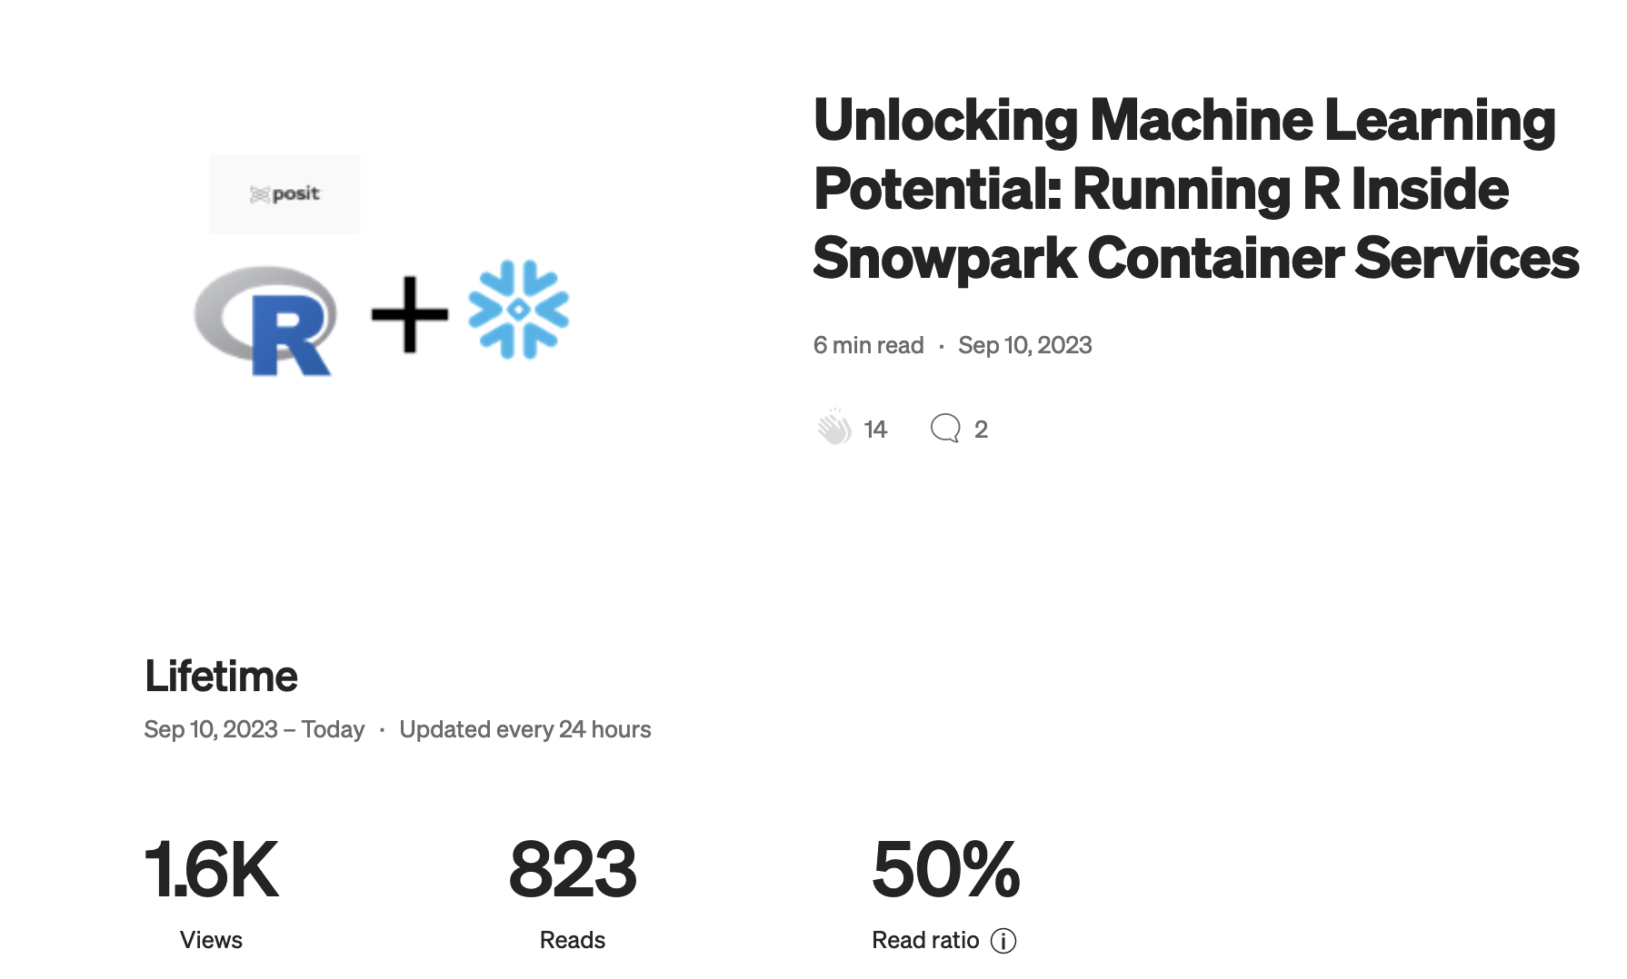
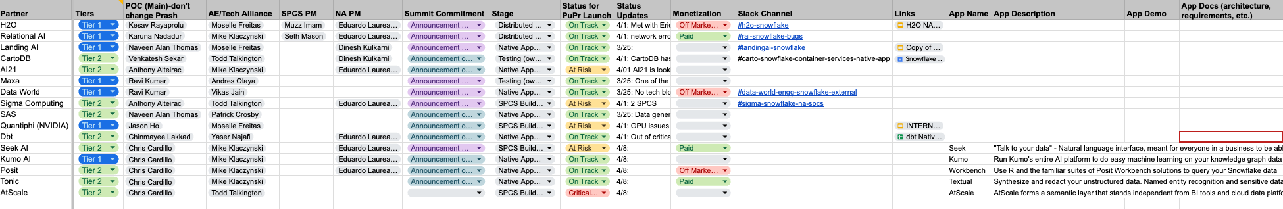

Why me ??
Proven track record
Repeating again this year
Believe in this Vision more than anyone else
Cross functional champion
Subject Matter Expert
Process driven
Love what I do

